Slide 1
Social Media Web Application using the MERN stack
FUN CLOUD
Project Mentor Name
Dr.Sangeeta Arora

Slide 2
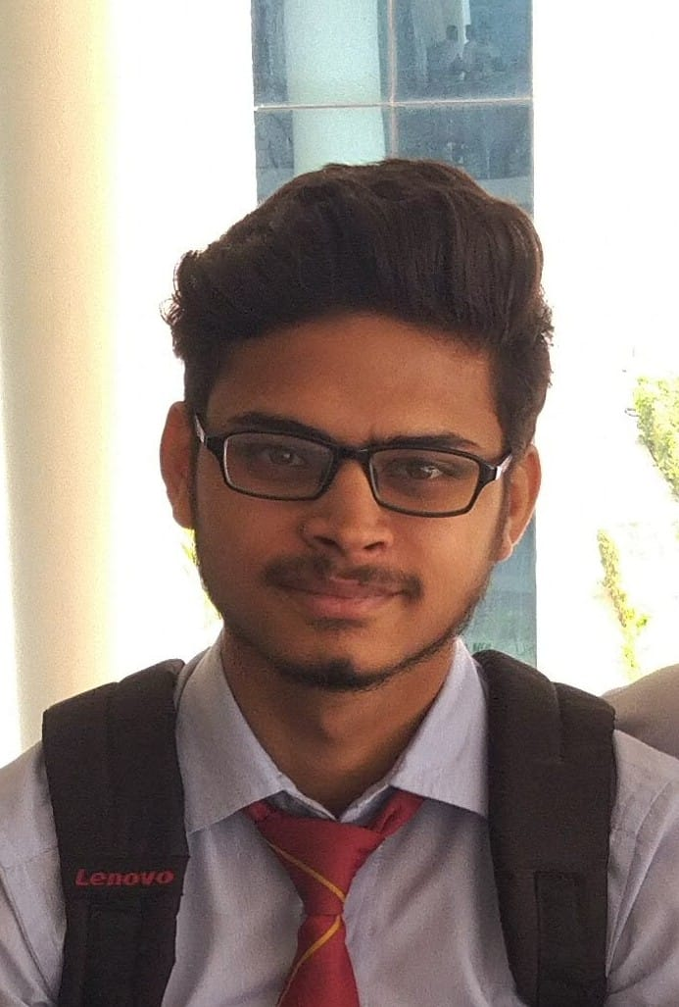
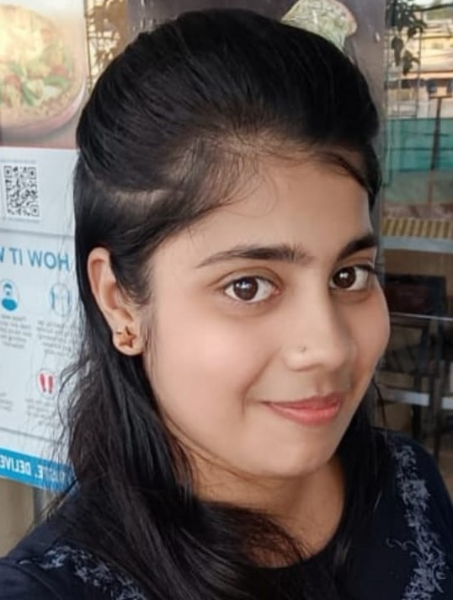
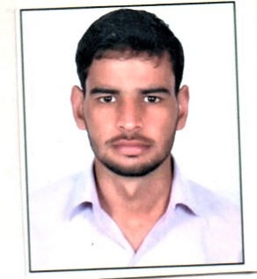
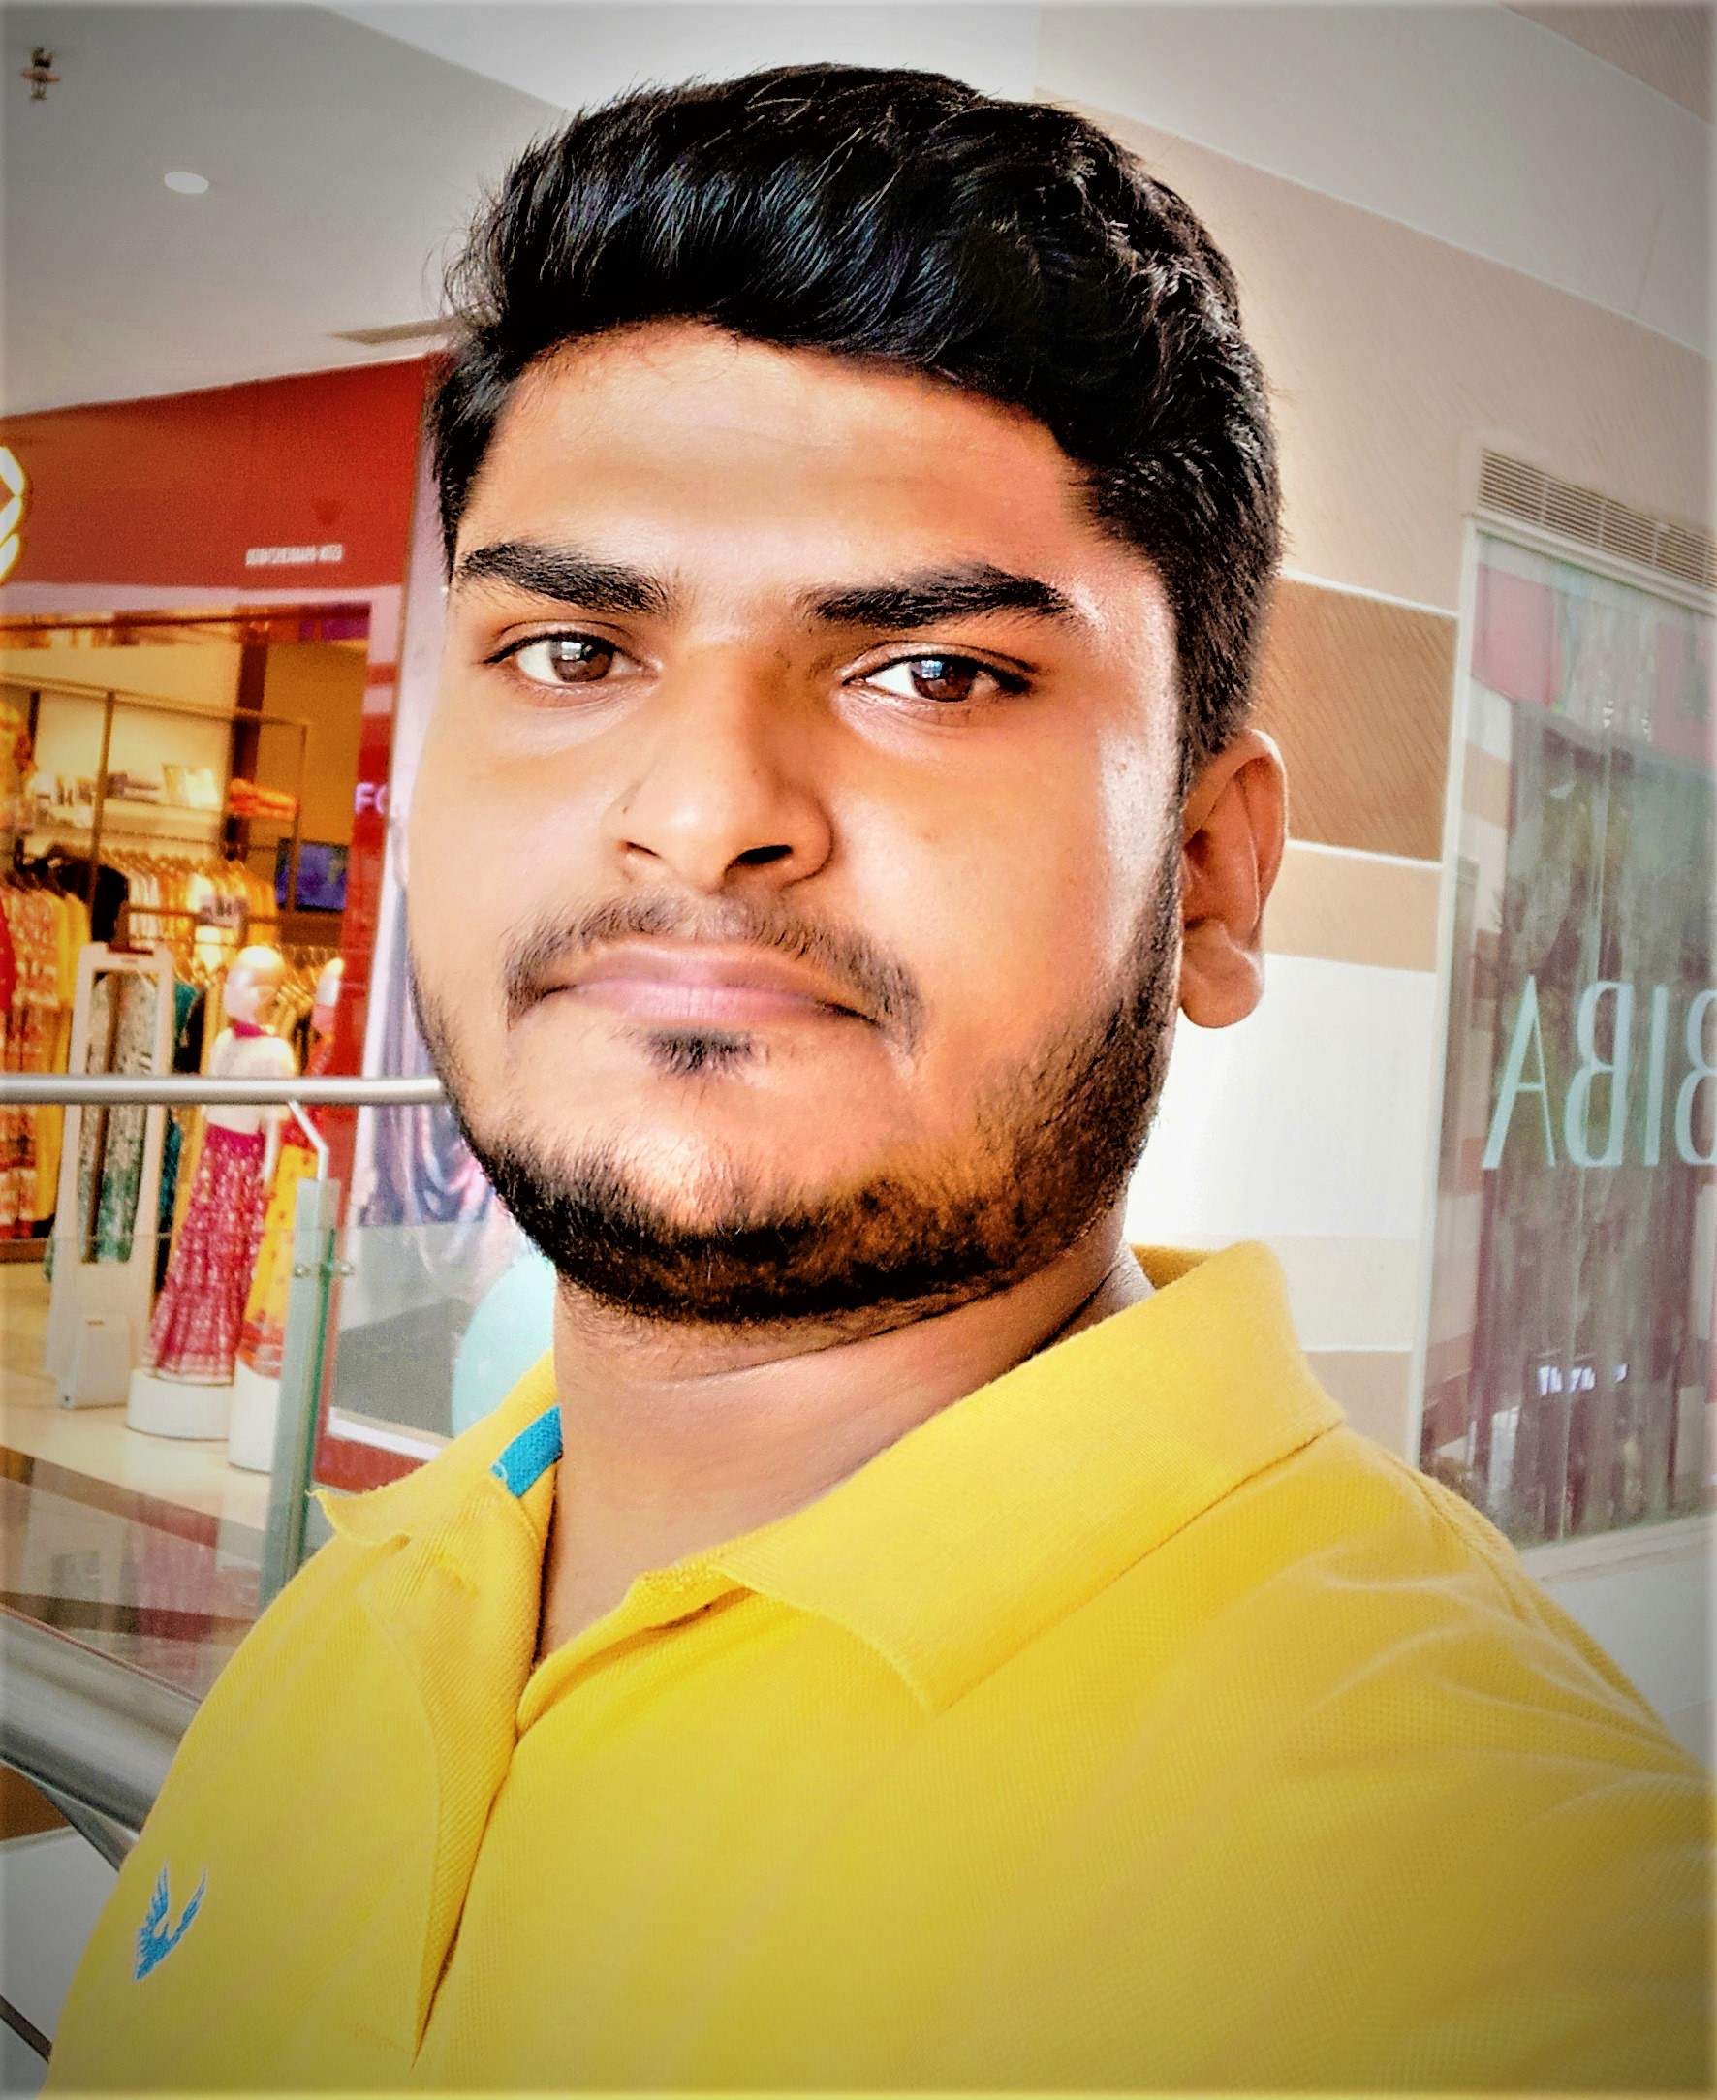
Team Leader
Mudit Rastogi
Team Member
Rashika Garg
Prabhat Chaudhry
Lokesh Gangwar

Slide 3

Introduction
Social media is a medium that is growing quite prevalent nowadays because of its user-friendly characteristics.
Social media platforms like Facebook, Twitter, Instagram, etc are allowing people to unite with each other across distances.
In other words, the entire world is at just one touch finger touch away and wholly thanks to social media. Today’s generation is particularly one of the most aggressive users of social media.

Slide 4
Technology
 | Front End | Back End | Database
Technology | React.js | Node.js and Express.js | MongoDB
Purpose | Building the UI of Application | Building the server using Express.js Frame work | Performing the database operation and implementing the functionality of the app such as creating post , following users and others.
Front End
Html ,CSS, Bootstrap5
Back End
Node Js , Express Js
Database
Mango DB

Slide 5
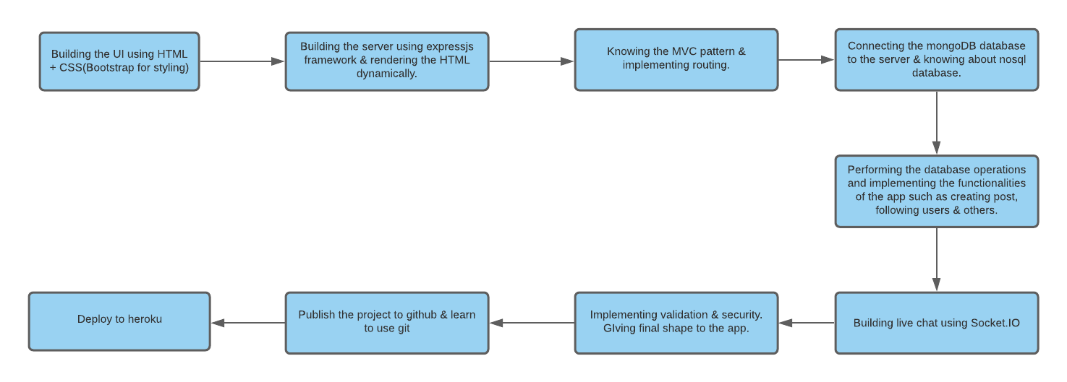
WORKING

Slide 7
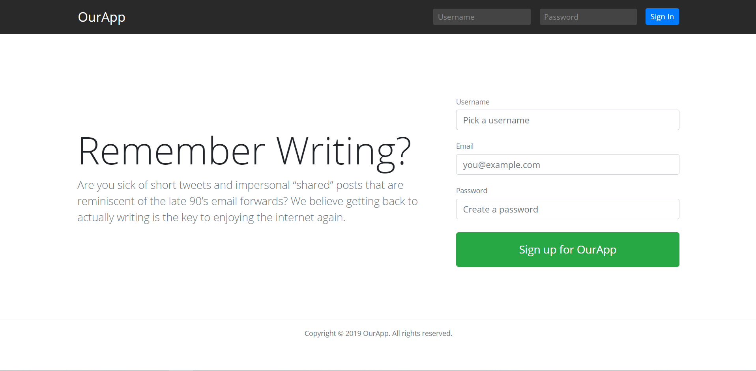
High Level Approach
jndfdn
Building this project will be a challenging task where you will get to learn and explore all about the MVC pattern, NoSQL Database (MongoDB) and much more.

Slide 8
Implementing authentication (login and signup) for users.
Building models for database and connecting database to server.
Building live chat using socket.IO.
Adding validators and security features to the project.

Slide 9
Primary Goal
Build this app from scratch and use it in your real life; best by adding some additional advanced features to this base project.
The main goal is to master your NodeJs and MongoDB skills and begin your full stack journey by developing this project.
After building this app, your goal should be implementing private chat, image upload in the post section and like, comment feature to make it more practical.

Slide 10
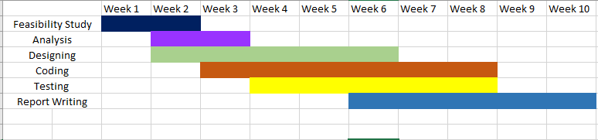
Gantt Chart

Slide 11

Application
You can use it among your friends or family and use it as a real world small scale social media application.

Slide 12
Thank You!!!

